Slide 1
Infobase presentation
Isabelle Massarelli, BFSSI
January 17, 2018

Slide 2
Objective:
Present the PHAC Infobase website as a mean to disseminate nutrition surveillance data products:
  Compendium of nutrient intake tables from the 2015 CCHS Nutrition
  Consumption food tables
  Other data (data visualization)

Slide 3
What is Infobase ?
A series of Internet based tools to help visualize, analyze, interpret and disseminate health indicator data for chronic disease, injury and child/maternal health
Surveillance and Epidemiology Division, Centre for Surveillance and Applied Research, Health Promotion and Chronic Disease Prevention Branch, PHAC
https://infobase.phac-aspc.gc.ca/

Slide 4
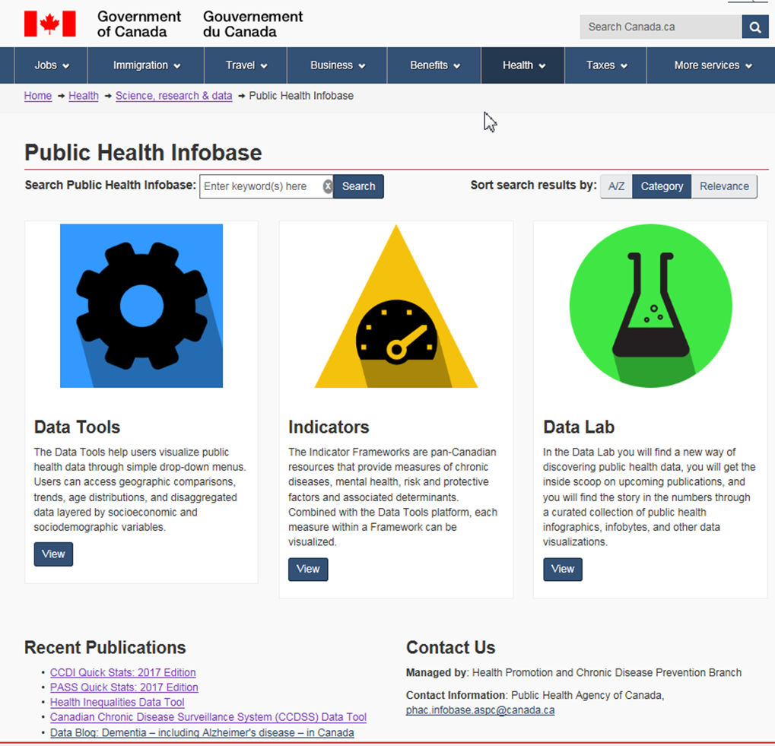

Slide 5
What is Infobase ?
DATA TOOLS: help users visualize public health data through simple drop-down menus. Users can access geographic comparisons, trends, age distributions, and disaggregated data layered by socioeconomic and sociodemographic variables
  Canadian Chronic Disease Surveillance System (CCDSS)
  Health Inequalities
  Congenital Anomalies in Canada
  Data Cubes
INDICATORS
DATA LABS : Data visualization (Big Picture Mortality in Canada Interactive)

Slide 6
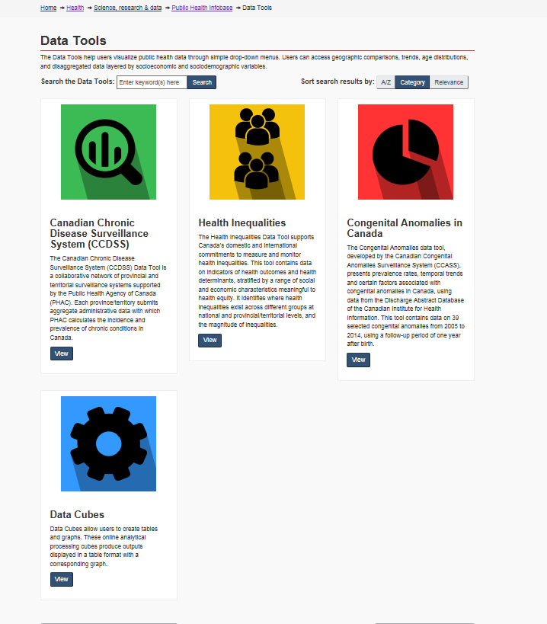

Nutrition
Surveillance
Data

Slide 7
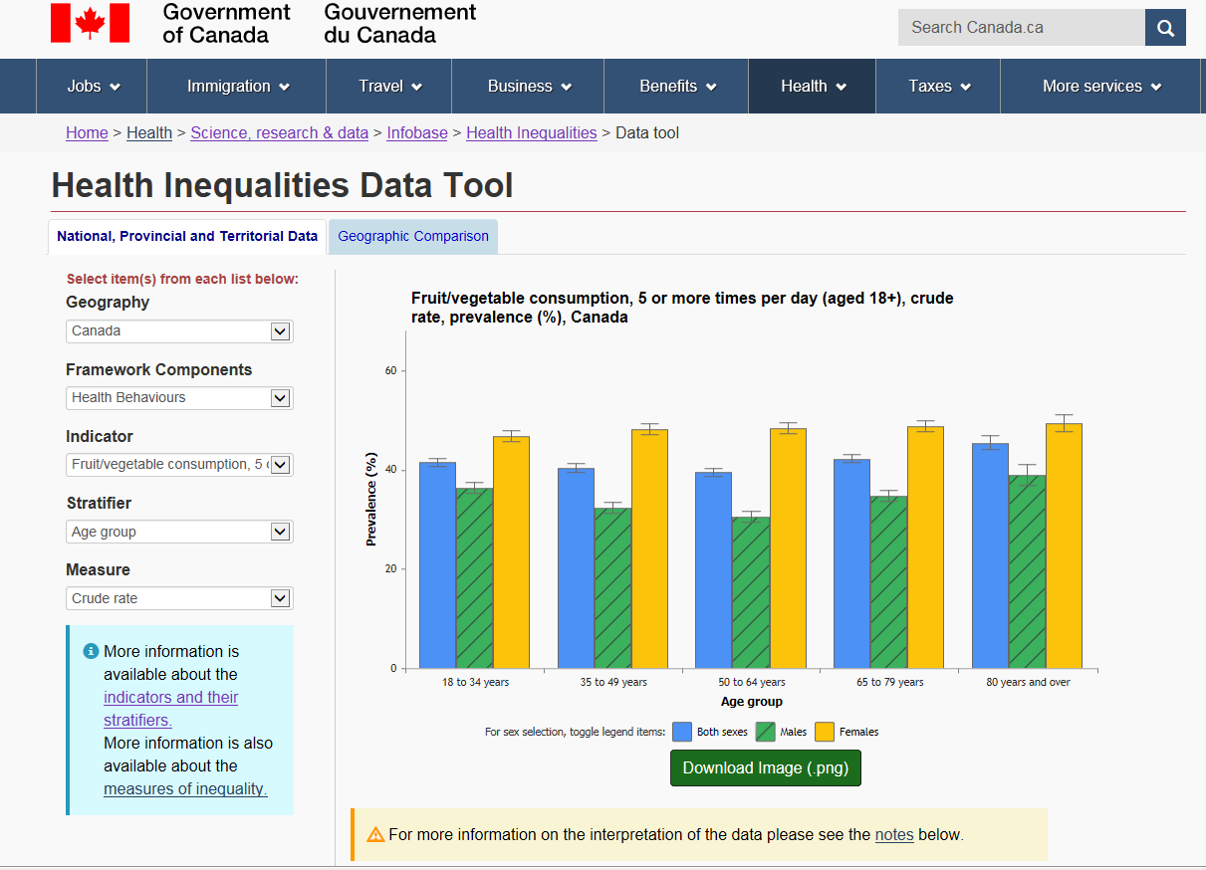

Slide 8
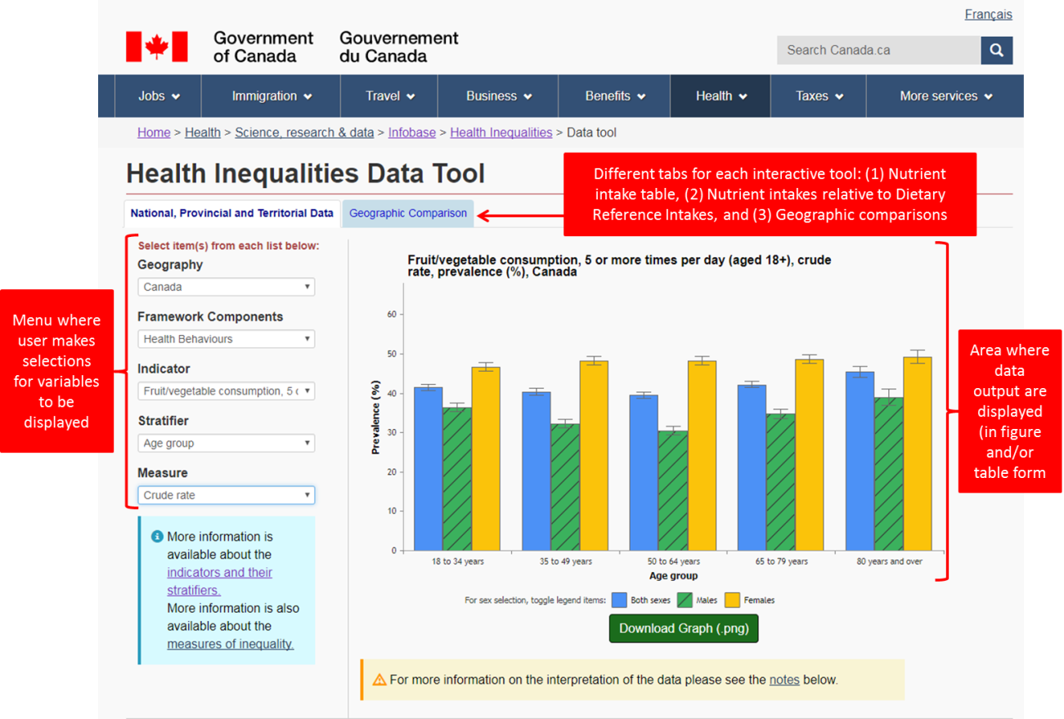

Slide 9
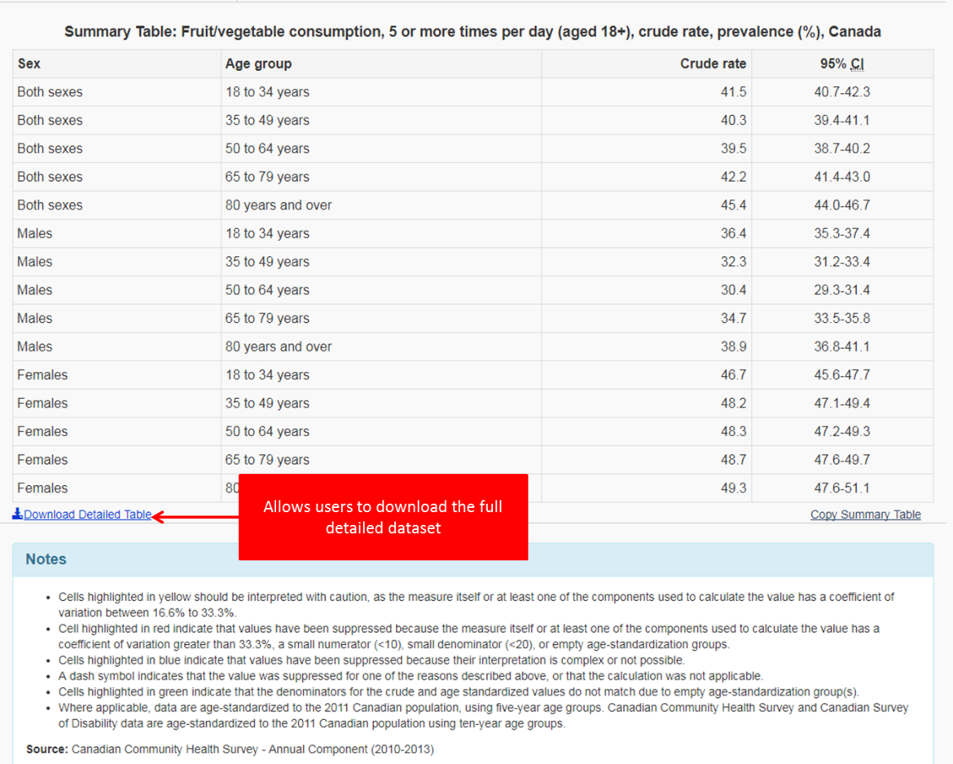

Slide 10
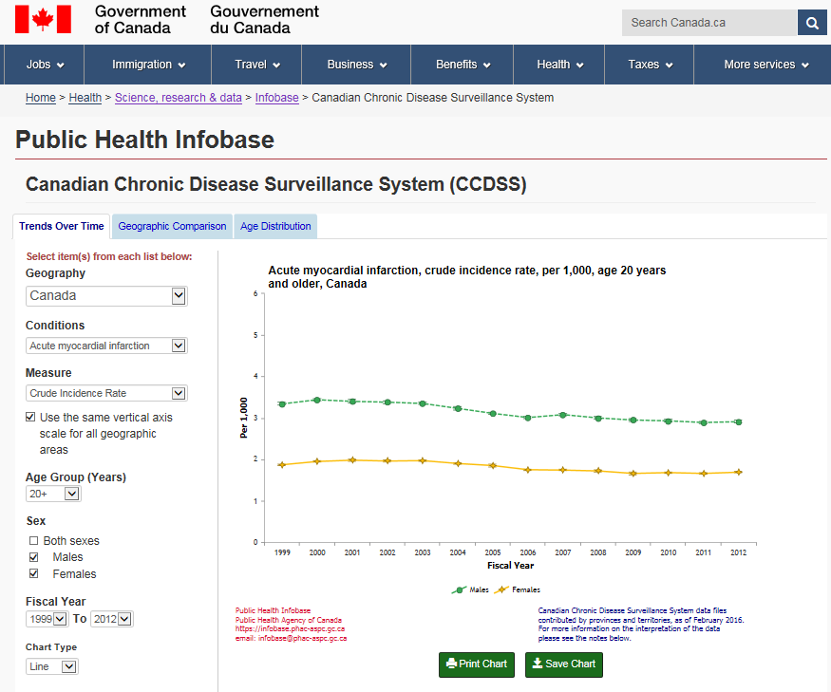

Slide 11
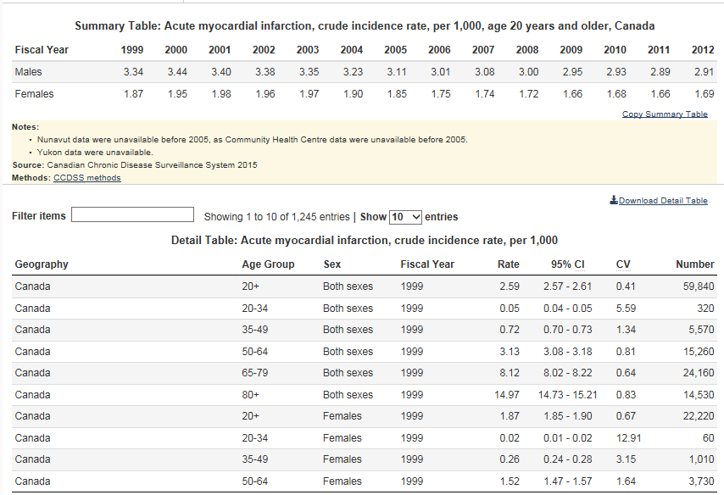

Slide 12
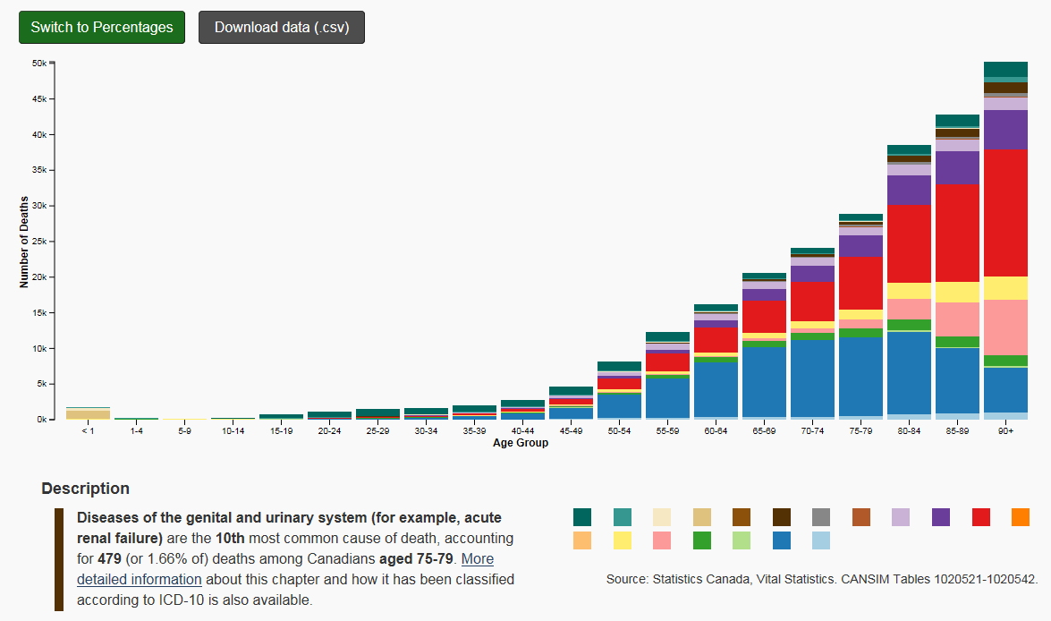
Data Blog: Big Mortality Data

Slide 13
Projected Timelines
January-March 2018: Selection of where the Nutrition Surveillance Dissemination Platform will be housed
March-April 2018: Nutrient intake tables available for all nutrients
April-June 2018: Programming and creation of customizable table and data visualizations
July-August 2018: Review of accessibility and user experience requirements.
September-December 2018: Posting and tracking of use/activity of site

